Slide 1


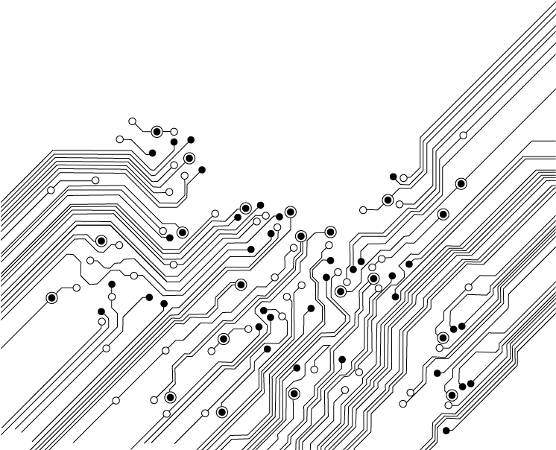
Deep Neural and Machine Learning Architectures for Context-Aware Hate Speech Classification in Urdu News
FAST NUCES, ISLAMABAD
Talha Aslam i24-8067
Muhammad Ahmer i24-7602
Supervisor: Sir Atif Saeed

Slide 2
CONTENTS
Step 03
WORKING
Step 05
CONCLUSIONS
Step 01
INTRODUCTION.
01
03
05
02
04
Step 02
METHODOLOGY
Step 04
RESULTS

Slide 3
INTRODUCTION
This project detects hate speech in Urdu news.
05
News articles are more formal and structured.
04
03
Most research focuses on social media, not news.
02
Hate speech in news is a growing problem.
01
Urdu news shapes public opinion.

Slide 4
METHODOLOGY
Final Classification
Data Acquisition
6
1
ML & DL Model Implementation
5
2
Urdu-Specific Text Preprocessing
4
3
Feature Engineering with TF-IDF
Lexicon-Based Binary Annotation

Slide 5
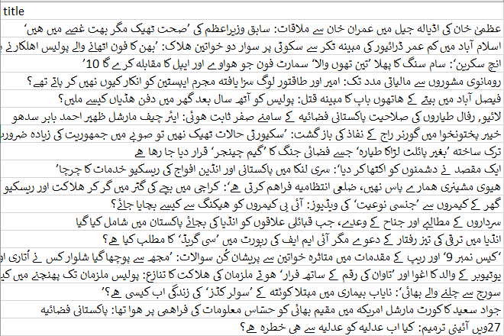
DATA ACQUISITION
Data was collected by web scraping four major
Urdu news outlets.
Articles, titles, and metadata were extracted from each source.
A custom scraper handled each website's unique HTML structure.
The collected data was cleaned and stored in a structured dataset.

Slide 6
Urdu-Specific Text Preprocessing
Urdu script and characters were normalized.
Language-specific noise and artifacts were removed.
A list of Urdu stopwords was applied.
Text was filtered for Urdu content quality.
NORMALIZE
Clean
Remove
Filter
Prepare

Slide 7
Machine Learning Models
o
Implemented XGBoost, Random Forest, SVM, Logistic Regression, and Naïve Bayes using TF-IDF features.

Slide 8
Deep Learning Models
o
Built and trained BiLSTM, CNN, a Hybrid CNN-BiLSTM, and a BiLSTM model with an Attention mechanism.

Slide 9
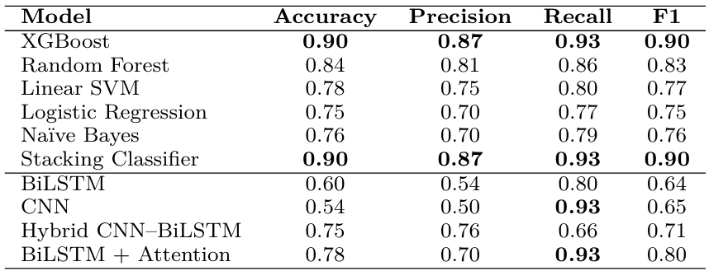
RESULTS

Slide 10
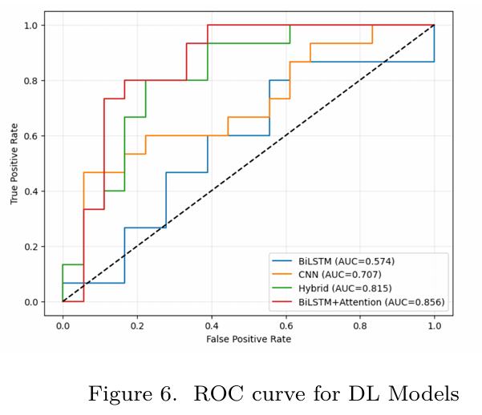
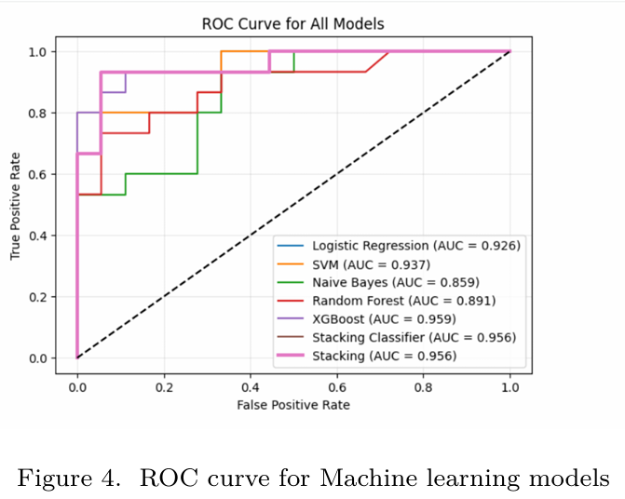
ROC Curves

Slide 11
Conclusions
Ensemble ML models, especially XGBoost,
delivered the best performance for this task.
Deep Learning models showed potential with
high recall but were limited by dataset size.

Slide 12
Future Work
Future work should expand the dataset and explore advanced transformer models for improvement.

Slide 13


